Slide 1
Sect. 5.5 Applications of Exponential and Logarithmic
Functions
© Copyright all rights reserved to Homework depot: www.BCMath.ca

Slide 2
Main Formulas:
Compound Interest:
Growth and Decay
Earthquakes:
Used for calculating how much is earned in interest depending on time, interest rate, and number of compounds in a year
Magic Formula!!
Carbon dating, radio active decay, population growth, continuous growth.
“N” growth/decay rate!
“R” magnitude on Richter scale. “I” refers to intensity, the amount of shaking on a seismometer.
Sound Intensity:
PH Levels:
“E” stands for energy released at the epicenter of an earthquake. “E” is measured in joules. For every increase of one unit on the Richter scale there will be 32 times more energy released!!
“P” ph level measures the level of acidity. Increase by 1 Ph level, substance is 10 times more acidic
“D” decibel measures the intensity of sound. For each increase of 10 decibels, sound is 10 times more intense!

Slide 3
I) Applications of Exponential and Logarithmic Functions:
Most applications are related to exponential growth or decay
Science: Population growth, bacterial growth, radioactive decay, PH Levels
For most of these applications, use the FINAL Equation:
Finance: Compound Interest, generating interest based on top of interest generated from a prior year.
For these applications, use the Compound Interest Formula:
Continuous Growth, use natural logarithms that uses “e” as the base: e = 2.718281828459045

Slide 4
II) Simple Interest $i=prt$vs Compound Interest: $A=p{\left(1+\frac{r}{n}\right)}^{n×t}$
“Interest” is the cost of borrowing, “Simple Interest” an amount compounded once based on a percentage of the principal {amount borrowed}
“COMPOUNDING” is the act of making the interest earned to become principal
“A concept of adding accumulated interest back to the principal so that interest is earned on interest from that moment on” ^{1 (wikipedia)}
Simple interest: No compound, pay interest only on what you owe
More compounds in a year will generate more interest
When there are multiple compounds in a year, split the annual interest rate by the number of compounds in a year
Ie: Interest is compounded monthly at 10% interest with a $10,000 deposit
© Copyright all rights reserved to Homework depot: www.BCMath.ca

Slide 5
The amount of money that is accumulated altogether. A = P + interest generated
The amount of money that was “borrowed” or “invested” at the very beginning
A percentage rate for the cost of borrowing
5% → r = 0.05 95% → r = 0.95
The time of the investment in years…. Convert all units of time into years!!!
© Copyright all rights reserved to Homework depot: www.BCMath.ca

Slide 6
Ex: John deposited $2000 in a bank at 5% interest compounded monthly. How much interest will he make in 15 years?
ii) Suppose John wants to earn $3000 in interest, how many years will need to deposit the $2000 at 5% interest compounded monthly.
Iii) Suppose John wants to deposit his $2000 at 5% interest for 20years. How much more will he earn if his interest is compounded daily vs semi annually?

Slide 7
Ex: John deposited $2000 in a bank at 5% interest compounded monthly. How much interest will he make in 15 years?
Gather information!!
Plug into formula
Subtract the Principal
From the Final Amount
© Copyright all rights reserved to Homework depot: www.BCMath.ca

Slide 8
ii) Suppose John wants to earn $3000 in interest, how many years will need to deposit the $2000 at 5% interest compounded monthly.

Slide 9
Iii) Suppose John wants to deposit his $2000 at 5% interest for 20years. How much more will he earn if his interest is compounded daily vs semi annually?

Slide 10
Ex: If John deposited $2000 in a bank at 4.5% interest compounded by the minute, how much interest will he make in 15 years?
Gather information!!
Plug into formula
Subtract the Principal
From the Final Amount
© Copyright all rights reserved to Homework depot: www.BCMath.ca

Slide 11
Ex: Tom is depositing $5000 in a savings account that pays 3% interest compounded semi-annually.
A) Find the equation for the accumulated amount b) Graph the equation for
C)Find how long he will need to keep the money in the bank to accumulate $10,000?
y
10^4
Tom will accumulate
$10,000 in his account
approximately after
23 years
5000
© Copyright all rights reserved to Homework depot: www.BCMath.ca
0
2
4
6
8
10
12
14
16
18
20
22
24
x

Slide 12
Ex: Tom is depositing $5000 in a savings account that pays 3% interest compounded semi-annually. How long will he need to keep the money in the bank to accumulate $10,000?
Ex: The population in Canada is increasing at an annual rate of 3.5%. If the current population is 20 million, when will the population reach 50 million people?
Ex: Tom has two options for investing. 1st: Mutual Fund that offers a return of 8%. 2nd Stock that offers quarterly dividends of 2.4%. Which investment will double faster?

Slide 13
Ex: The population in Canada is increasing at an annual rate of 3.5%. If the current population is 20 million, when will the population reach 50 million people?
The population of Canada will
reach 50 million approximately
27 years
© Copyright all rights reserved to Homework depot: www.BCMath.ca

Slide 14
Practice: Tom is depositing $5000 in a savings account that pays 3% interest compounded semi-annually. How long will he need to keep the money in the bank to accumulate $10,000?
Gather information!!
Plug into formula
© Copyright all rights reserved to Homework depot: www.BCMath.ca

Slide 15
III) Using the FINAL Equation:
All of the applications below uses the FINAL equation in a slightly different way
Population size, earthquake magnitudes, radio-active decays, Ph levels, sound intensity, and so on
“I” is the initial amount, what you have in the beginning
“F” is the final amount, what you have at the end
“N” is growth or decay rate,
  Double N = 2 Half Life N = 0.5 10 times more N =10
  Triple N = 3 Earthquakes, Sound Intensity, PH level N =10
“L” the time it takes for the growth rate/decay rate to occur
  If half life is 5300 years L = 5300
  Earthquakes L = 1, Sound Intensity L =10, Ph Levels L = 1
  “L” is the times it takes “N” to occur
“A” time it takes to go from “Initial” to “Final” amount
© Copyright all rights reserved to Homework depot: www.BCMath.ca

Slide 16
III) The FINAL equation:
Double Time: The time it takes a population or the weight of an object to double its size or value
Half – Life: The time it takes a population or object to depreciate to half its size or value
The amount can be a dollar value, mass, or count. In general, “I” what you have at the beginning and “F” is what you have at end
How fast is the growth or decay is occuring
NOTE: “I” and “F” will have the same unit of measurement
Both are either in grams (weight), percentages (amount), count
NOTE: “A” and “L” will have the same unit of measurement
Time elapsed/passed to go from initial amount to final amount
Both are either in days/minutes (time), scales (Richter scale), distance (meters)
Ie: Time it takes a
population to double
Ie: 8 years required to reach Half - Life
“A” is how long it takes to go from “I” to “F”
Annually: L = 8 with N = 0.5
“L” is how long it takes for “N” to occur
© Copyright all rights reserved to Homework depot: www.BCMath.ca

Slide 17
Ex: Suppose a colony of 1000 rats triple every 2 weeks. What will the population be after 100 days?
After 100 days the population
of rats will be 2,55,638

Slide 18
Ex: A colony of cockroaches started with 12 and doubles every 15 days,
a) How many cockroaches will there be in 60 days?
b) After how many days will the population be over 10,000?
c) What is the annual rate of growth?
After 60 days the population
will increase to 192
cockroaches
© Copyright all rights reserved to Homework depot: www.BCMath.ca

Slide 20
b) After how many days will the population be over 10,000?
After 146 days, the population
of the cockroaches will be
over 10,000!!
c) What is the annual rate of growth?
If we are looking for an annual rate of growth, think of it as
simple interest for one year
“R” is the annual rate, “T” is the number of years
For annual rate, “T = 1” and “A = 365”
Write this as a percentage!
The cockroach population will increase at a rate of 2,113,976,655% annually
© Copyright all rights reserved to Homework depot: www.BCMath.ca

Slide 21
IV) How Does Radiocarbon Dating Methods Work?
Carbon data is used to find the age of fossils and old objects
There are two types of carbon in our bodies C12 & C14
Carbon intakes occur through eating plants → plants obtain carbon through atmosphere
C12 – Stable isotope of carbon - used for determining “Initial” amount
C14 – Unstable, decays (Radioactive) (2 extra neutrons) – “final” amount
Living tissues have equal amounts of both carbon
When an organism dies, carbon intake ceases and the ratio of C12 to C14 is locked.
Ratios of C12 to C14 are measured to calculate the age
Half life of C14 is 5730 years….
Method of calculating age (3 step process)
http://www.biblicalchronologist.org/answers/c14_method.php
© Copyright all rights reserved to Homework depot: www.BCMath.ca

Slide 22
Ex: The half life of C-14 is 5730 years. A piece of fossil has 820g of C-12 and 13g of C-14. How old is the fossil?
Ex) A radio active substance decays 20% in 120 years. What is the half life of the substance?
© Copyright all rights reserved to Homework depot: www.BCMath.ca

Slide 23
Ex) A radio active substance decays 20% in 120 years. What is the half life of the substance?
© Copyright all rights reserved to Homework depot: www.BCMath.ca

Slide 24
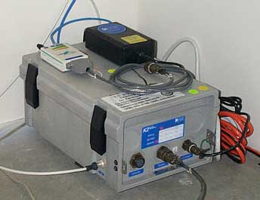
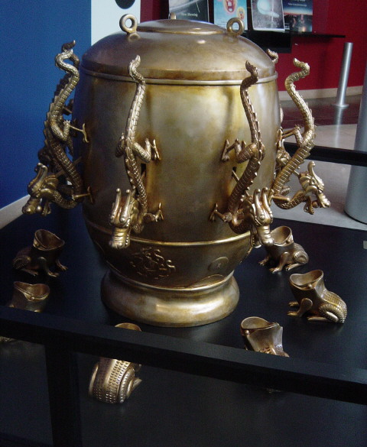
IV) Richter Scale
The amount of power from a earthquake is measured using the Richter scale, from 0 to 10 (greatest ever)
The number is used to quantify the seismic energy & shaking amplitude released by an earthquake
The scale is based on a logarithmic value of base 10
An increase of 1 unit in magnitude on the Richter scale has an increase of 10 times the shaking amplitude
Calculated by taking the logarithm of the combined horizontal amplitude of the largest displacement from zero on a Wood–Anderson torsion seismometer output.
Seismometer
Invented by the
Chinese in 192Ad
© Copyright all rights reserved to Homework depot: www.BCMath.ca

Slide 25
Valdivia Earthquake (Chile) 1960 - 9.5
For each increase in Richter scale of 1 unit, the amplitude of the shake is 10 times greater!
Great Cascadia EQ, BC 1700 – 9.0
Valparaiso, Chile 1906
8.6 Deaths: 22,000
An earthquake with a Richter scale of 7 is 100 times greater in amplitude “shaking” than an earthquake with a Richter scale of 5
Great
Queen Charlott e Eq, BC 1949 – 8.1
2001 Gujarat, India
7.7 Deaths: 20,085
1908 Messina, Italy
7.5 Deaths: 83,000
IF we are to measure “ENERGY”, an increase in R.S. of 1 unit is has 32 times more energy!!
Major
Strong
Most of the questions from this chapter are about comparing the intensities of two earthquakes from their Richter scales
Hiroshima
Atomic Bomb
Moderate
Small
Construction
Site Blast
Minor
1
2
3
4
5
6
7
8
9
© Copyright all rights reserved to Homework depot: www.BCMath.ca

Slide 26

This is what a 9.6 in the heart of San Francisco would look like:

Slide 27
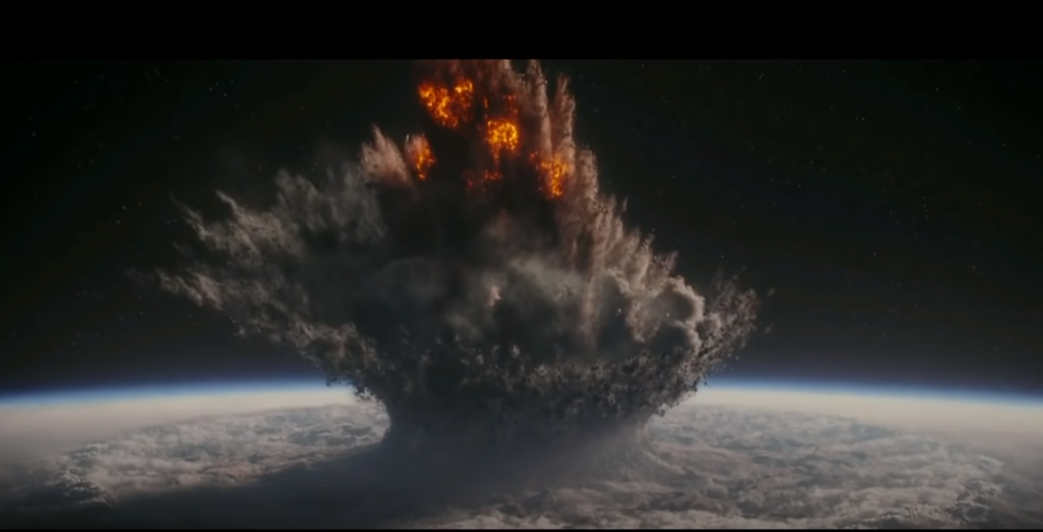
This may be an example of a 11 or 12….. Not too sure…
https://youtu.be/EgsQCI5MkyE

Slide 28
Most earthquake questions in Math 12 will compare the intensity of different earthquakes
  Ie: how many times one EQ is bigger than another
Ex: How many times as greater was the earthquake in Valparaiso, Chile EQ (8.6) than the Messina, Italy EQ (7.5)?
Difference or Increase
in Richter Scale
Intensity of
greater EQ
Intensity of
smaller EQ
The Valparaiso EQ was 12.6 times
Greater than the Messina EQ
© Copyright all rights reserved to Homework depot: www.BCMath.ca

Slide 29
Practice: The Hiroshima Bomb has a Richter Scale of 5.0. What is the Richter scale of another bomb that is twice as intense?
NOTE: the larger intensity is twice as the smaller intensity
The increase in R.S. is unknown.
For each whole-number increase in magnitude, the seismic energy released increases by about 32 times. That means a magnitude 7 earthquake produces 32 times more energy — or is 32 times stronger — than a magnitude 6. An earthquake with a Richter scale of 4 is equivalent to 6 tonnes of TNT explosives. Around 1700, BC had an earthquake of 8.7. How much TNT would that be equivalent to?
The Richter Scale will be 0.301029995
greater than the R.S. of the Hiroshima
Bomb.
© Copyright all rights reserved to Homework depot: www.BCMath.ca

Slide 30
For each whole-number increase in magnitude, the seismic energy released increases by about 32 times. That means a magnitude 7 earthquake produces 32 times more energy — or is 32 times stronger — than a magnitude 6. An earthquake with a Richter scale of 4 is equivalent to 6 tonnes of TNT explosives. Around 1700, BC had an earthquake of 8.7. How much TNT would that be equivalent to?

Slide 31
IV) Light and SOUND Intensity:
From this point on, we will look at how to apply the FINAL equation into different context
We need to identify the base “N” – rate of growth and “L” – lifetime, the change required for the rate of growth to occur
Ex: Sunlight travelling in ocean water loses 15% per meter in ocean depth. If a boat is 50meters underwater, how much sunlight is visible at that depth?
As we move deeper into the ocean, the amount of light decreases
So “I” and “F” should be percentages.
The rate of decrease is 15%, so N=0.85, because that is what you “keep”!!
“L” is 1 meter, because you lose 15% for every meter that you drop
Ex: If light decreases by 15% each meter, at what depth will there be only 1% of light left?
© Copyright all rights reserved to Homework depot: www.BCMath.ca

Slide 32
Light Intensity decreases
as it travels deeper into
the ocean
© Copyright all rights reserved to Homework depot: www.BCMath.ca

Slide 33
© Copyright all rights reserved to Homework depot: www.BCMath.ca

Slide 34
Ex: If light decreases by 15% each meter, at what depth will there be 1% of light left?
© Copyright all rights reserved to Homework depot: www.BCMath.ca

Slide 35
Loss of light (percent) in one metre of seawater*
 | violet |  | blue-green |  |  | yellow | orange | red
wavelength (micrometre) | 0.30 | 0.40 | 0.46 | 0.50 | 0.54 | 0.58 | 0.64 | 0.70
oceanic water, most transparent | 16% | 4% | 2% | 3% | 5% | 9% | 29% | 42%
oceanic water, least transparent | 57% | 16% | 11% | 10% | 13% | 19% | 36% | 55%
coastal water, average |  | 63% | 37% | 29% | 28% | 30% | 45% | 74%
*According to Jerlov.
http://original.britannica.com/eb/article-9116162/Loss-of-light-percent-in-one-metre-of-seawater
© Copyright all rights reserved to Homework depot: www.BCMath.ca

Slide 36
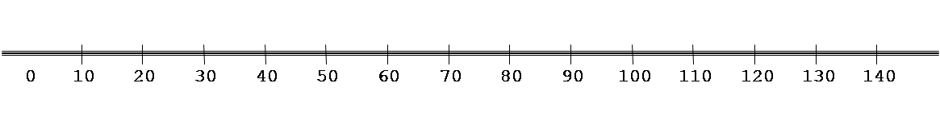
V) Sound Intensity
Sound intensity is measured in decibels (dB), so “A” and “L” are measured in change in decibels
For every increase in 10 dB is an increase of 10 times in loudness (N=10)
Change in dB
Greater
Intensity
IF Cheong is 20 decibels greater, then he is 100 times louder!!!!
Smaller Intensity
The Decibel Scale (dB)
Threshold
of hearing
Threshold
of Pain
IF Cheong is 30 decibels greater, then he is 1000 times louder!!!!
Normal Conversation
Mr. Cheong’s
class
Soft
whisper
Busy street
Traffic
Rock Concert
Front row
© Copyright all rights reserved to Homework depot: www.BCMath.ca

Slide 37
VI) pH Levels (Acids & Base)
PH levels measures the acidity/alkalinity of certain solutions
PH levels range from 0 (Acidic) to 14 (Base) and 7(Neutral), for each decrease in PH level, the acidity will increase by 10 times greater
Base (N) is 10, “A” and “L” are measured in PH levels…. “L = 1”
Acid
Neutral
Base
For each 1 unit decrease is
a 10 fold increase in acidity
For each 1 unit increase is
a 10 fold increase in alkalinity
Change in pH levels
Gerater
intensity
Smaller
intensity
© Copyright all rights reserved to Homework depot: www.BCMath.ca

Slide 38
Ex: The Ph of lemon juice is 2 and tomato juice is 4.5. How many times more acidic is Lemon juice?
Ex: Vinegar has a Ph of 2.5 and is 300,000,000 times more acidic than bleach. What is the PH of bleach?
Ex: A soft conversation is approx. 30db. a shouting match with Cheong is around 95db. How many times greater is the sound intensity is the shouting match vs a soft conversation?
Ex: Listening to music with a pair of ear phones could be a million times greater in sound intensity than a normal conversation at 50db. How many db is listening to music with earphones?

Slide 39
Ex: The Ph of lemon juice is 2 and tomato juice is 4.5. How many times more acidic is Lemon juice?
© Copyright all rights reserved to Homework depot: www.BCMath.ca

Slide 40

Return to Previous Slide
© Copyright all rights reserved to Homework depot: www.BCMath.ca

Slide 41
What is Amortization?
Amortization is about borrowing a large amount of money with an interest rate, then paying that money back over time in regular payments
Suppose you want to purchase a house that is worth $2,000,000. Most people would borrow that money from the bank [mortgage]
There is a cost to borrowing, that cost is based on an interest rate
[current rate is 6.5%]
You will be required to make monthly mortgage payments, where part of that money goes to paying interest, and part goes to reducing your “principal”
Depending on how much your monthly payments are, most people take 15 to 25 years to pay off their mortgage
NOTE: if you fail to make your monthly mortgage payments, the bank can initiate “foreclosure”, resulting in the loss of your property

Slide 42
Ex: Suppose John takes out a mortgage to purchase a property that is worth $20,000 with an interest of 3% annually. If his monthly mortgage payment is $100, how much will he owe after 5 years?
This part is how much you borrowed plus all the interest that is generated so far!
This part is how much you have paid into your mortgage and the interest that is generated from those payments
The difference is the amount that you still owe into your mortgage
When you pay off your entire mortgage, this part will be equal to zero!!!
The number of compounds depends on the number of monthly mortgage payments
This part is just an geometric series….easy lah……!!

Slide 43
Ex: Suppose John takes out a mortgage to purchase a property that is worth $20,000 with an interest of 3% annually. If his monthly mortgage payment is $100, how much will he owe after 5 years?
So after 5 years, there will be 60 mortgage payments
The interest from each monthly mortgage payment is:
The amount that he still owes after 5 years will be:
So after 5 years, John still owes $16767.67 with his mortgage

Slide 44
How to Calculate How much You still owe:
First determine the total number of interest compounds:
Number of Interest Compounds
(N)
Number of Compounds in a year (n)
Number of years
(T)
Number of Payments in your last year
How much you still owe in your mortgage
The principal multiplied by the interest rate to the power of the number of total compounds
The geometric series of all your monthly payments with the ratio equal to the interest rate
Principal: The amount you borrowed in the beginning
N: The number of interest compounds
“i” : The annual interest in decimal form

Slide 45
How to calculate your Monthly mortgage payments:
When your mortgage is paid off, the amount owing with your mortgage will be equal to zero!
Use basic algebra to calculate your monthly mortgage payments:
How much you owe will be equal to
The principal multiplied by the interest rate to the power of the number of total compounds
The geometric series of all your monthly payments with the ratio equal to the interest rate

Slide 46
Ex: Suppose John renews his mortgage for another 5 years, his next mortgage payment will also be $100
a) How much of this next mortgage payment will go into paying interest?
b) How much of this next mortgage payment will go into reducing the principal that is still owed?
c) What is the minimum monthly mortgage payment that John must make so that his mortgage will not increase? [note: This amount is known as the trigger point]
d) Suppose we went back to the beginning when John owed $20,000 in his mortgage with an annual interest rate of 3%. If John wanted to pay off his mortgage in 5 years, how much should his monthly mortgage payment be?

Slide 47
Ex: Suppose John renews his mortgage for another 5 years, his next mortgage payment will also be $100
a) How much of this next mortgage payment will go into paying interest?
If John still owes $16767.67 into his mortgage after 5 years, the amount of his next payment that will go into paying interest will be:
This means that your next mortgage payment, $41.92 will go into paying interest!
b) How much of this next mortgage payment will go into reducing the principal that is still owed?
If your next mortgage payment is $100, then $58.08 will go into paying down the principal

Slide 48
c) What is the minimum monthly mortgage payment that John must make so that his mortgage will not increase? [note: This amount is known as the trigger point]
If you don’t want to increase your mortgage, then your payment must be enough to cover the interest amount.
This means that your mortgage must be atleast $41.92 from the 5 year point. If your monthly payment is less than the monthly interest generated, the mortgage amount will increase. Which means that you will be paying forever!!

Slide 49
d) Suppose we went back to the beginning when John owed $20,000 in his mortgage with an annual interest rate of 3%. If John wanted to pay off his mortgage in 5 years, how much should his monthly mortgage payment be?
First we need to determine the number of mortgage payments
n = 12 T = 5
Five years, 12 payments per year = 60 mortgage payments!
If the mortgage is paid off, then the amount remaining will be equal to zero!!!
If John wants to pay off his mortgage within 5 years, his monthly mortgage payment should be $359.37

Slide 50
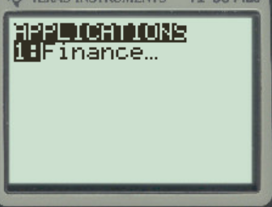
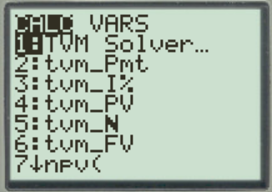
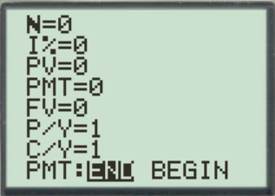
Ti83 Finance APP
Your Graphing Calculator also has a finance app that helps you calculate mortgage values:
First type in all the values that you are given and indicate what you want to solve for
“N” is the total number of compounds altogether
I% is the annual interest rate in percentage form
PV is the “present value” or the Principal that is owing
FV is the “future value”, if you want the mortgage to be paid off then FV is zero!
P/Y is the number of payments per year, if monthly then P/Y = 12
C/Y is the number of compounds per year

Slide 51
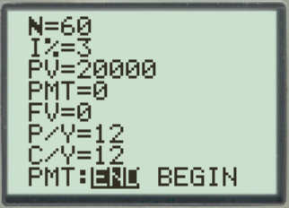
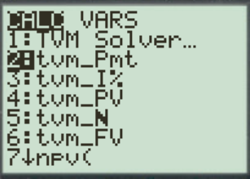
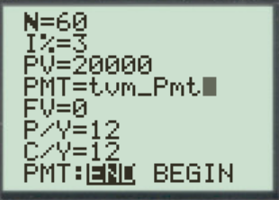
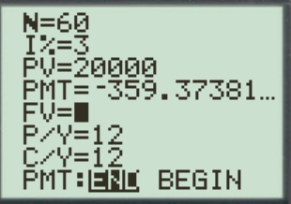
d) Suppose we went back to the beginning when John owed $20,000 in his mortgage with an annual interest rate of 3%. If John wanted to pay off his mortgage in 5 years, how much should his monthly mortgage payment be?
Go back to “Finance” and highlight #2: to solve for the monthly pmt!
Leave the PMT as zero temporarily
The monthly payment will be $359.37
Then just press enter!

Slide 52
Jason has a mortgage of $500,000 at a interest rate of 2.2% annually compounded monthly. [ie: Interest is generated each month] If Jason is paying $4000 each month to his mortgage, how much would he owe after 10 years?
ii) How long will it take Jason to payoff his mortgage at this rate?
iii) After 10 years, Jason decides to make a lumpsum of $50,000 to offset his principal. How much faster will this help payoff his mortgage?
iv) Suppose Jason wants to payoff his mortgage within 10 years, how much should his monthly mortgage payment be?

